Slide 1


MATH 4995 Project 1: Supervised Classification with Full Spectrum or Premium Subset? (Home Credit Default Risk dataset)
Presenter: SHAO Zhihao
Date: 19/10/2021

Slide 2
Table of Contents:
Introduction
Dataset Description
Exploratory Data Analysis
Feature Engineering and Selection
Modelling
Results
Analysis

Slide 3
Table of Contents:
Introduction
Dataset Description
Exploratory Data Analysis
Feature Engineering and Selection
Modelling
Results
Analysis

Slide 4

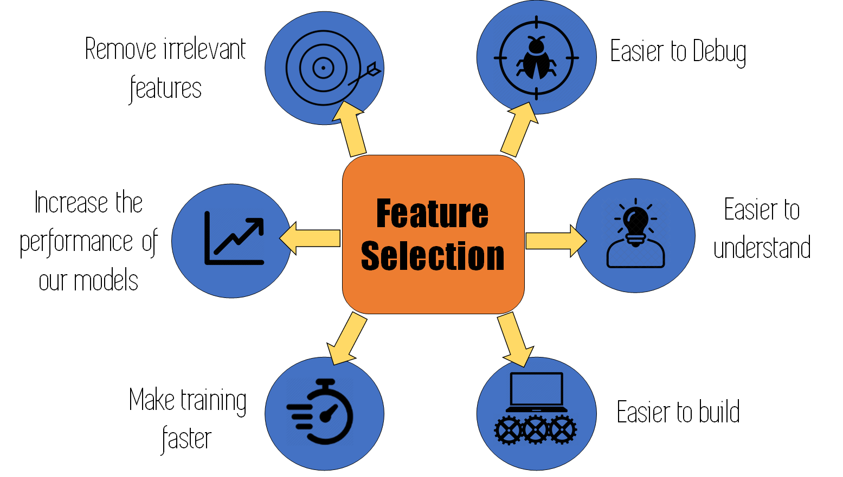
Introduction:
Many people struggle to get loans due to insufficient or non-existent credit histories. In order to make sure this underserved population has a positive loan experience, Home Credit is challenging kagglers to makes use of a variety of alternative data to predict their clients’ repayment abilities.
https://www.kaggle.com/c/home-credit-default-risk/overview
“A Million-Dollar Question”:
Should I feed my model with a full set of features without selection, or a small subset after close examination?
Which one would support a better prediction?
If any difference, how large is it and is it worth the time I spend on selection?
https://www.google.com/url?sa=i&url=https%3A%2F%2Fwww.omnisci.com%2Ftechnical-glossary%2Ffeature-selection&psig=AOvVaw3-q1aDkQGeLgutZx91ws3j&ust=1634653480531000&source=images&cd=vfe&ved=0CAsQjRxqFwoTCIjaiPWU1PMCFQAAAAAdAAAAABAD
Notes:
I always have a question in my mind upon being assigned a similar task: should I feed my model with a full set of features without selection, or a small subset after close examination? Which one would support a better prediction? If any difference, how large is it and is it worth the time I spend on selection?
In this project, I explored this problem on several common statistical and machine learning methods used in binary classification.

Slide 5
Table of Contents:
Introduction
Dataset Description
Exploratory Data Analysis
Feature Engineering and Selection
Modelling
Results
Analysis

Slide 6
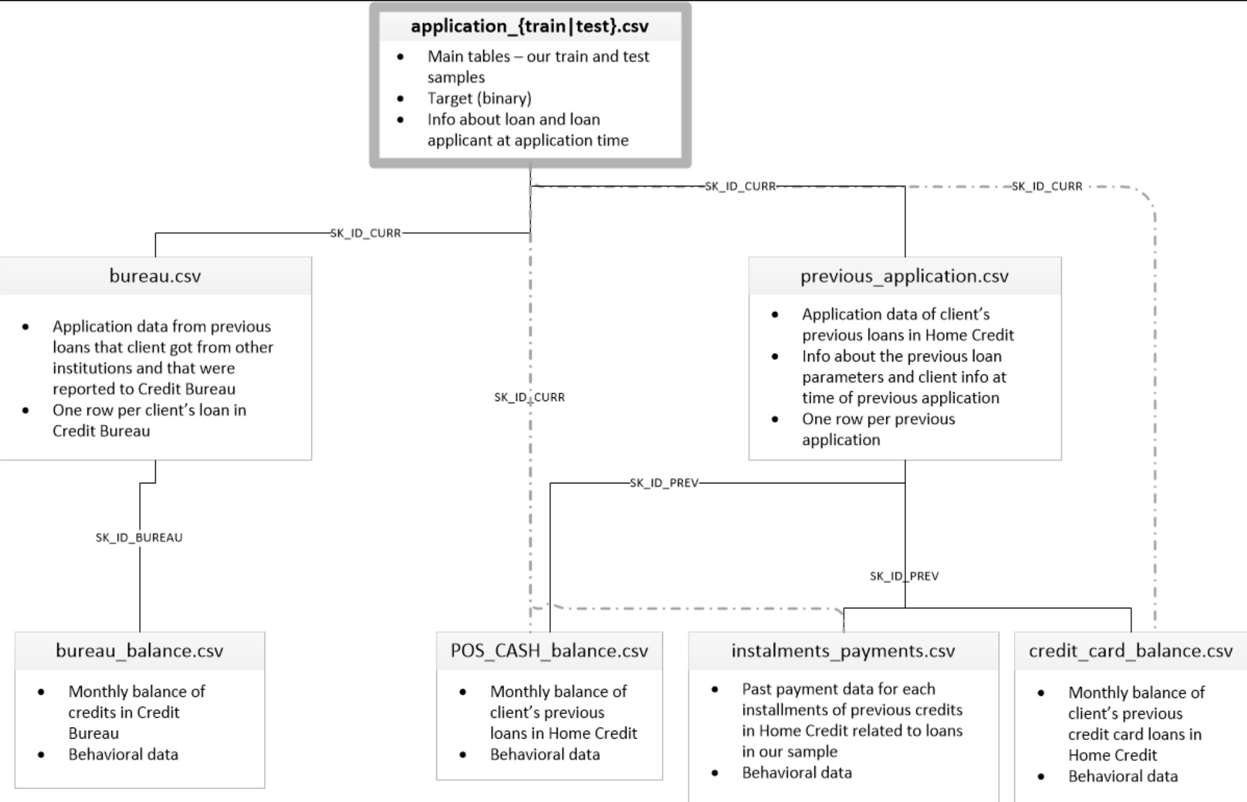
Dataset Description:
There are 7 different source of data:
Application_train/test
Bureau
Bureau_balance
Previous_application
Pos_cash_balance
Credit_card_balance
Installments_payment
Notes:
Due to the time limit, in this project I only used the main application training and testing data, which means that the models presented later were trained on incomplete data. The result here is just a baseline prototype that we can then improve upon.

Slide 7
Table of Contents:
Introduction
Dataset Description
Exploratory Data Analysis
Feature Engineering and Selection
Modelling
Results
Analysis

Slide 8
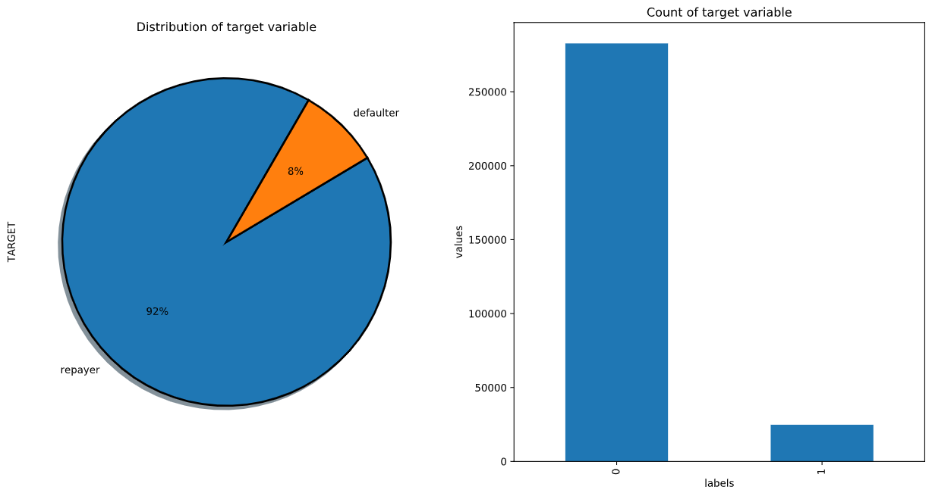
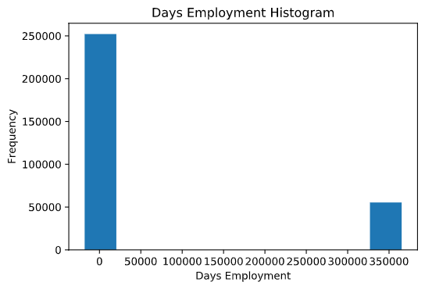
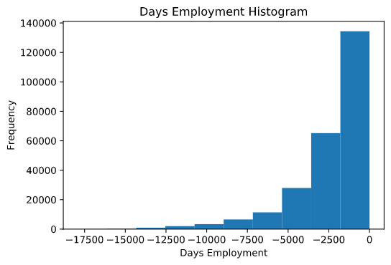
Exploratory Data Analysis:
Response variable – “TARGET”:
This is a standard supervised classification task. The binary label ‘TARGET’ are included in the training data, with 0 (will repay loan on time) or 1 (will have difficulty repaying loan)
Predictors:
Data type
Normality
Multicolinearity
Missing value status
Correlation with response variable
Example: Anormal distribution of “DAYS_EMPLOYED”
Notes:
Imbalanced distribution of response variable

Slide 9
Table of Contents:
Introduction
Dataset Description
Exploratory Data Analysis
Feature Engineering and Selection
Modelling
Results
Analysis

Slide 10
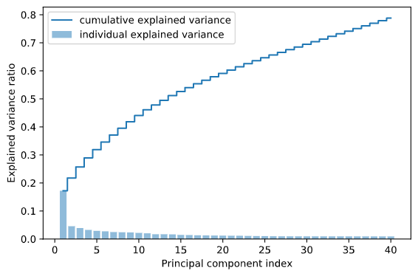
Feature Engineering:
Fill in missing values
Numerical: median
Categorical: mode
(can be improved by MICE regression mentioned by Jasper)
Label-encoding categorical predictors
Dimensionality reduction by PCA
Top 40 components which can explain about 80% of the data variance

Slide 11
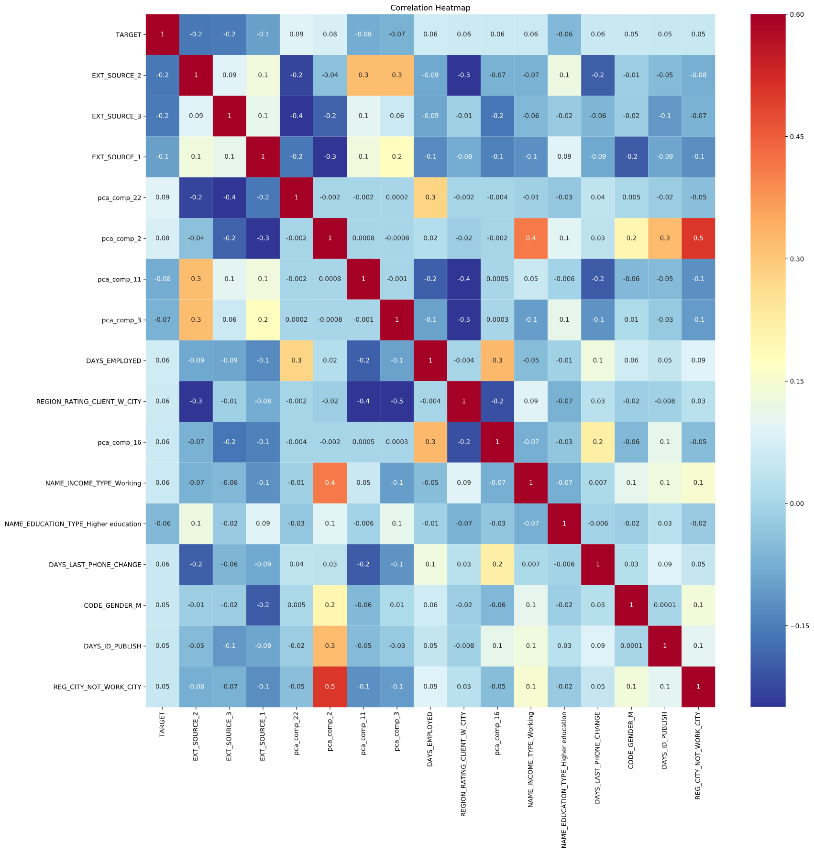
Feature Selection:
“Full spectrum”: all 285 predictors
”Premium subset”: 16 predictors after manual inspection
Highest correlation with response
Remove multicolinearity (VIF > 10 & > 0.6 correlated with other predictors)
Notes:
The EDA suggests that most original features show weak correlation (absolute value < 0.1) with the response variable. In order to reduce the dimensionality, I conducted PCA analysis and extracted top 40 components which can explain about 80% of the data variance. Furthermore, 16 predictors with highest correlations were selected.

Slide 12
Table of Contents:
Introduction
Dataset Description
Exploratory Data Analysis
Feature Engineering and Selection
Modelling
Results
Analysis

Slide 13
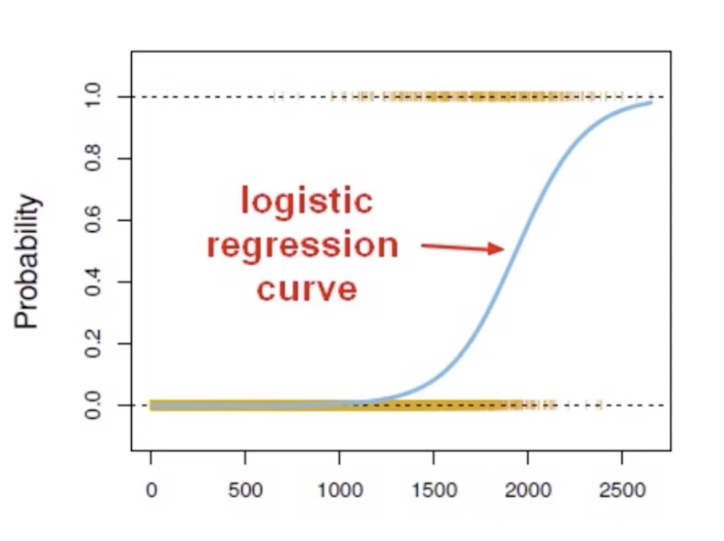
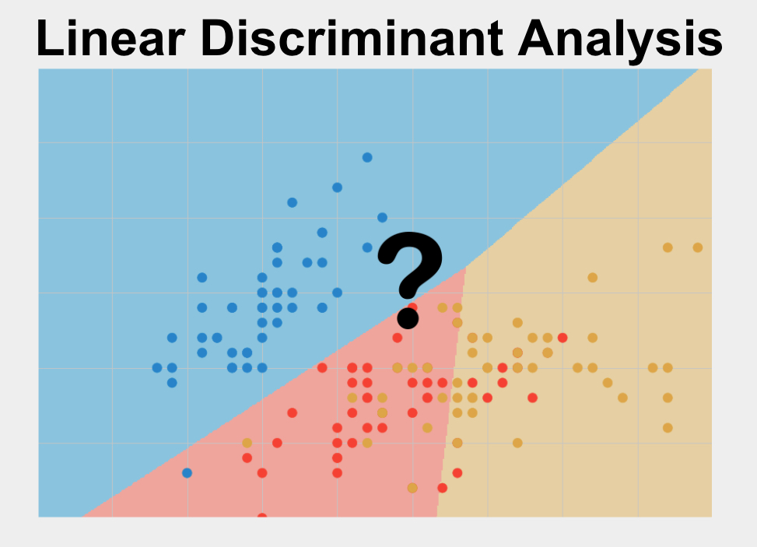
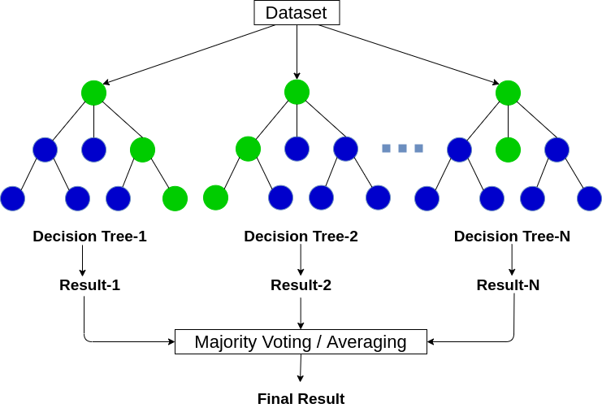
Modelling:
Three models were explored:
Logistic regression;
Linear discriminant analysis;
Random forest (n_estimators: 100).
The models were built upon “full spectrum” (285 predictors) and “premium subset” (16 predictors), respectively.
5-fold cross validation was performed for model selection.
Notes:
The EDA suggests that most original features show weak correlation (absolute value < 0.1) with the response variable. In order to reduce the dimensionality, I conducted PCA analysis and extracted top 40 components which can explain about 80% of the data variance. Furthermore, 16 predictors with highest correlations were selected.

Slide 14
Table of Contents:
Introduction
Dataset Description
Exploratory Data Analysis
Feature Engineering and Selection
Modelling
Results
Analysis

Slide 15
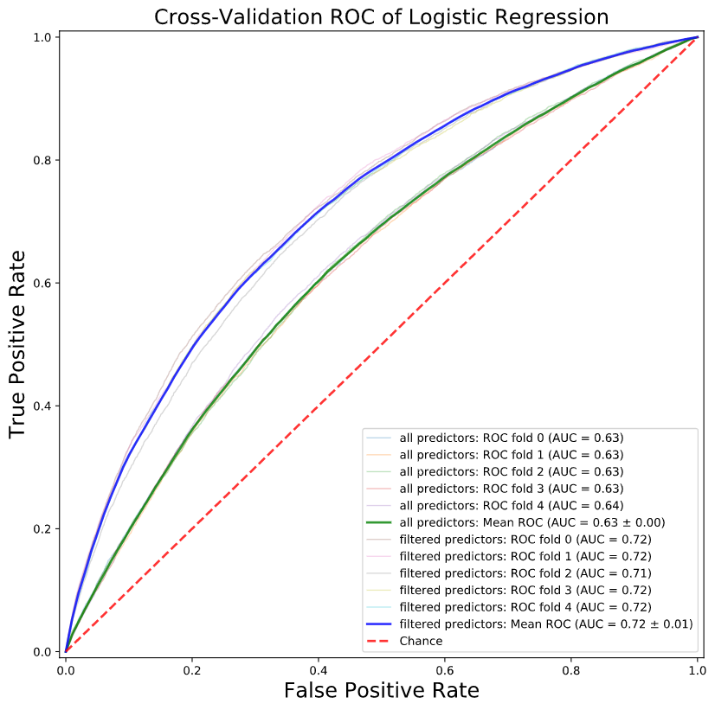
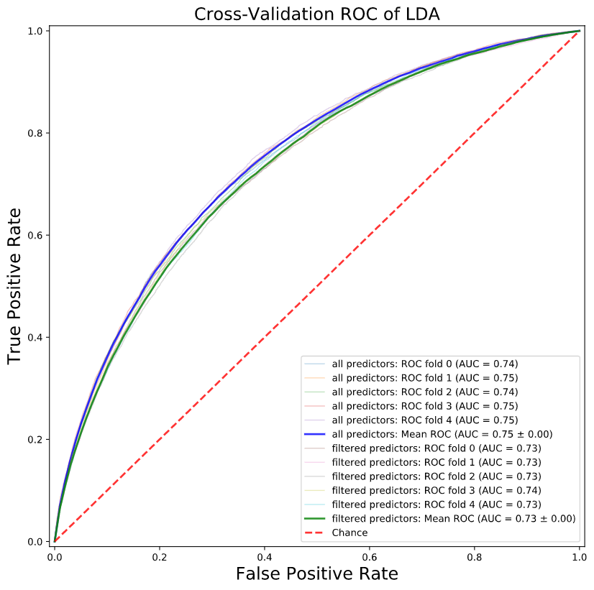
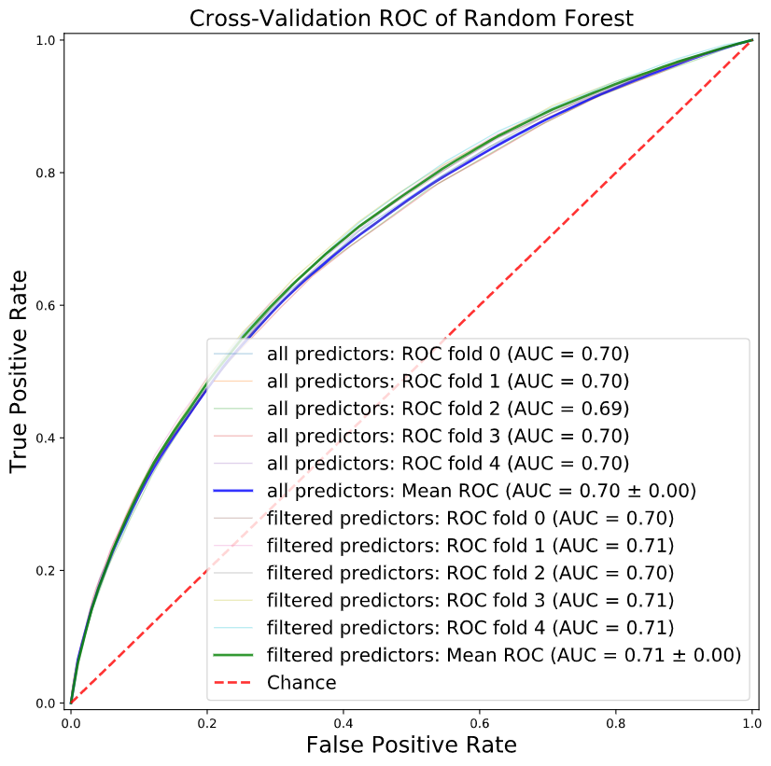
Results:
Logistic Regression
LDA
Random Forest
The best AUC score on test dataset is 0.73731
Notes:
The EDA suggests that most original features show weak correlation (absolute value < 0.1) with the response variable. In order to reduce the dimensionality, I conducted PCA analysis and extracted top 40 components which can explain about 80% of the data variance. Furthermore, 16 predictors with highest correlations were selected.

Slide 16
Table of Contents:
Introduction
Dataset Description
Exploratory Data Analysis
Feature Engineering and Selection
Modelling
Results
Analysis

Slide 17
Analysis:
In logistic regression, the model built with filtered predictors outperforms the other one, indicating that the exclusion of multicollinearity improves such generalized linear model.
Such improvement is not significant in LDA or random forest, maybe because LDA is inherently based on stronger assumptions?
No multicollinearity
Homoscedasticity
Normality
As for random forest, one of its intrinsic advantages compared to bagging is to reduce inter-tree correlation, so it can accommodate a large number of features.
Notes:
The EDA suggests that most original features show weak correlation (absolute value < 0.1) with the response variable. In order to reduce the dimensionality, I conducted PCA analysis and extracted top 40 components which can explain about 80% of the data variance. Furthermore, 16 predictors with highest correlations were selected.

Slide 18
Analysis:
Methods like best subset selection/forward (backward) stepwise selection were not used here mainly because the total number of predictors (285) is too large for my weak laptop (╥_╥)
Or any suggestion to apply such subset selection in this situation?
Relatively low AUC scores of my models may be attributed to
Insufficient data retrieval
Suboptimal number of filtered predictors
(can be improved by grid search)
Notes:
The EDA suggests that most original features show weak correlation (absolute value < 0.1) with the response variable. In order to reduce the dimensionality, I conducted PCA analysis and extracted top 40 components which can explain about 80% of the data variance. Furthermore, 16 predictors with highest correlations were selected.

Slide 19
The end. Any question is welcomed!

